Slide 1
Study of Immune Epitopes: Java vs. Python
Allen Cao

Slide 2
Objectives
Query epitopes from IEDB database
BLAST them against proteomes and antigens
Filter out results
Use filtered epitopes in studies

Slide 3


Java vs Python
Java
More robust
Faster, more efficient
Longer syntax
Python
Suits smaller projects
Less code
Simpler

Slide 4
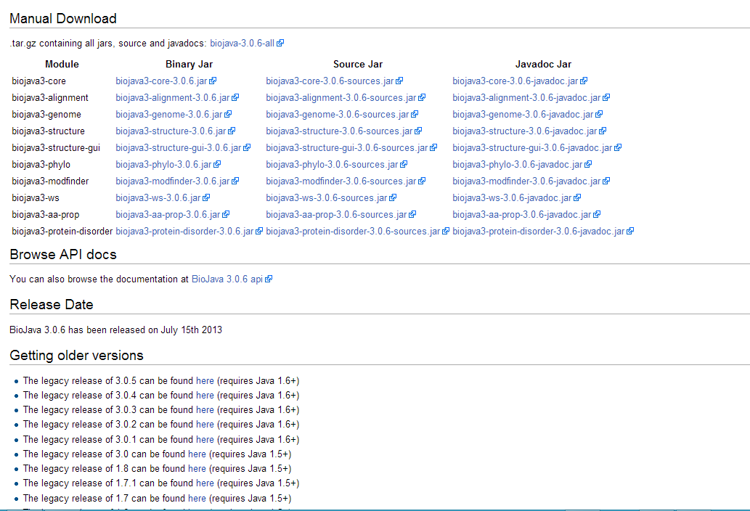
BioJava vs BioPython
BioJava
Unfriendly installation process
Multiple versions of BioJava and Eclipse
Maven? Plugins?
Manually add .jar
BioPython
Simple installation
Works with all versions

Slide 5
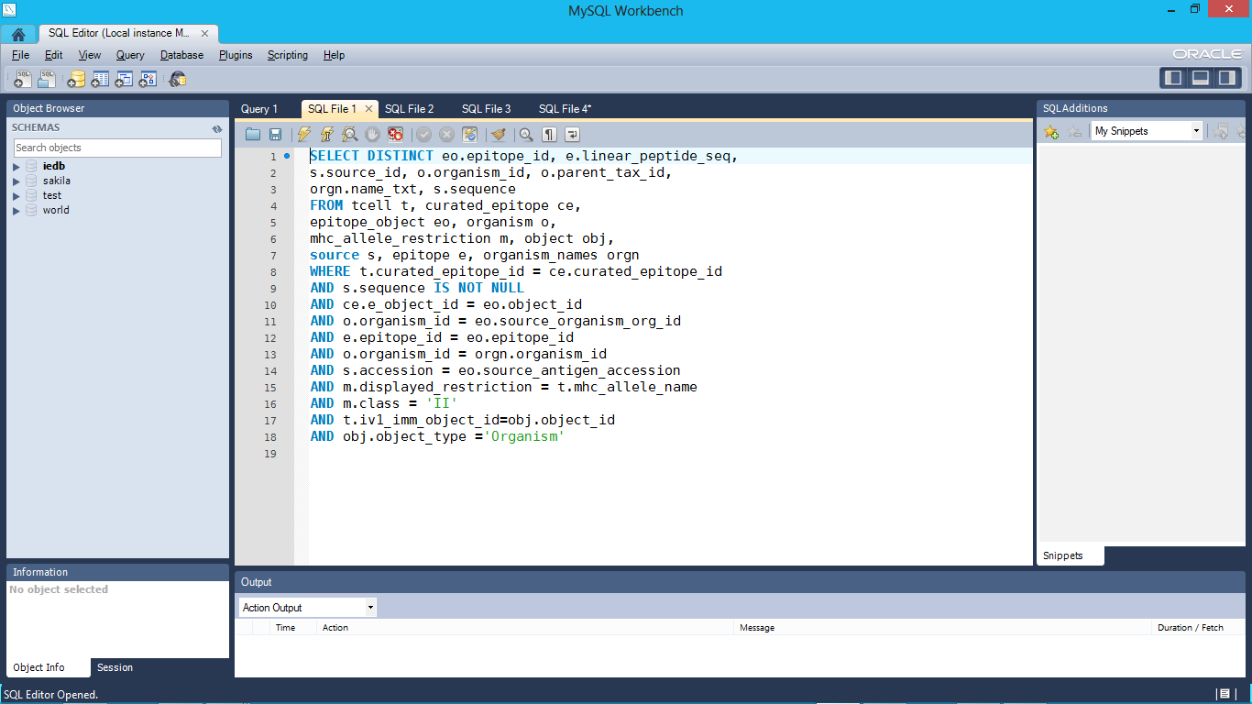
Querying IEDB
Can be done in Java or Python
Only need to generate fastas once
Python: import MySQLdb
Java: import java.sql.*;
May need to re-query
from IEDB to access
additional information.

Slide 6
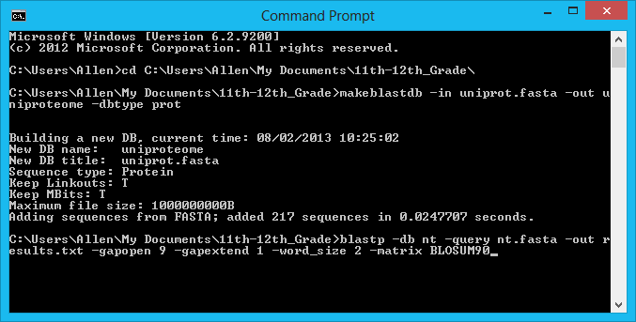
BLASTing
Programmatic access
URLAPI or installation
Command line for both
BioPython: import NcbiblastpCommandLine

Slide 7
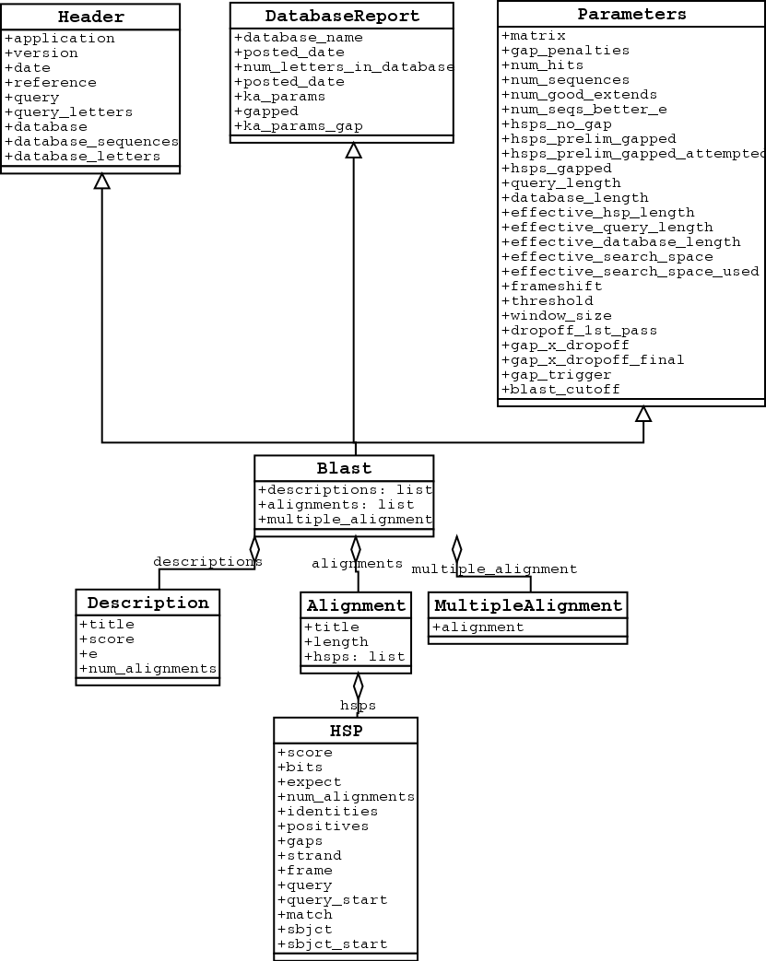
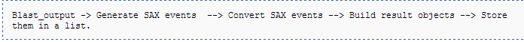
Parsing BLAST
Need to sort through results
Java Raw blast output:
txt, xml, csv
BioPython:
from Bio.Blast import NCBIXML

Slide 8
Summary
Python is more suited for small-scale projects, as it is a scripting language. Java, although faster and more robust, is a poorer fit for our needs. Python’s syntax also complements short, looping programs while Java’s syntax defines things more clearly but takes more space.

